Slide 1
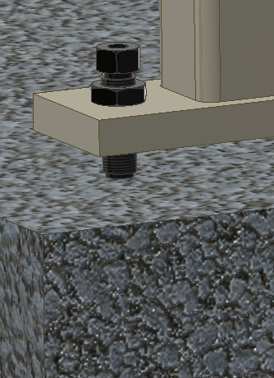
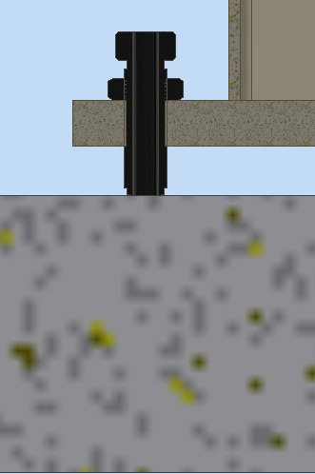
Jam nut
Basic Leveling Jack
Screw leveling jack body through the tapped base and adjust to desired height.
Secure with jam nut against base frame.
When ordering the basic leveling screw, it is recommended that the customer provides a leveling pad between the screw and the floor to distribute the weight properly.
Customer supplied leveling pad
recommended

Slide 2
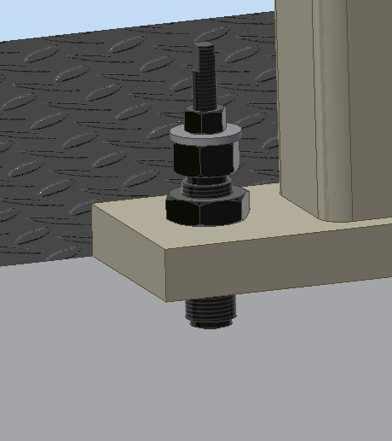
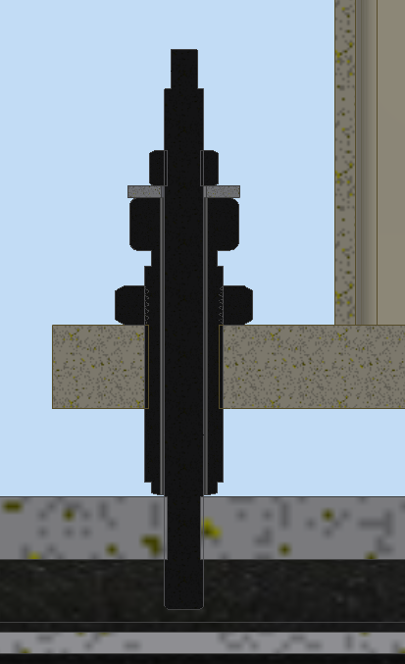
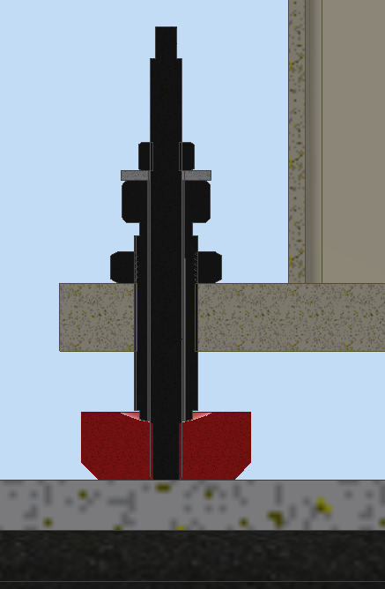
Threaded
stud
Existing Tap /existing base Applications
For existing tap application, screw leveling jack body through the tapped base and align to hole.
Screw threaded stud into existing tap and keep jam nut loose.
Adjust height and secure with jam nut against base frame.
Secure threaded stud to leveling jack with upper jam nut.
For existing frame with mounting block, Screw leveling jack through the tapped base and locate into mounting block
Screw threaded stud into mounting block leaving upper jam nut loose.
Adjust height and secure with jam nut against base frame.
Secure threaded stud to leveling jack with upper jam nut.
Jam nut
Tapped
frame
Threaded
stud
Existing tap
Jam nut
Tapped frame
Existing mounting base

Slide 3
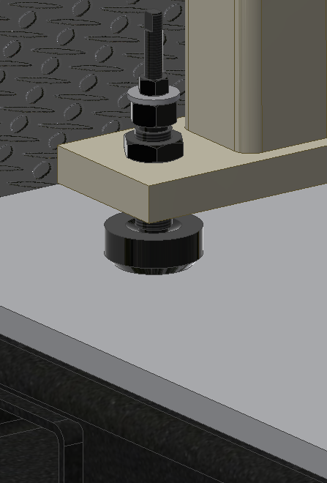
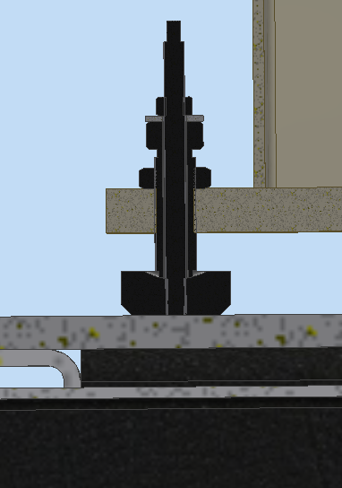
Threaded
stud
Weld down Applications
Screw leveling jack body through the tapped base and locate into mounting block
Screw threaded stud into mounting block leaving upper jam nut loose.
Adjust height and secure with jam nut against base frame.
Secure threaded stud to leveling jack with upper jam nut.
Weld entire perimeter of puck to support structure.
Jam nut
Tapped frame
Weld entire
perimeter
Metal base

Slide 4
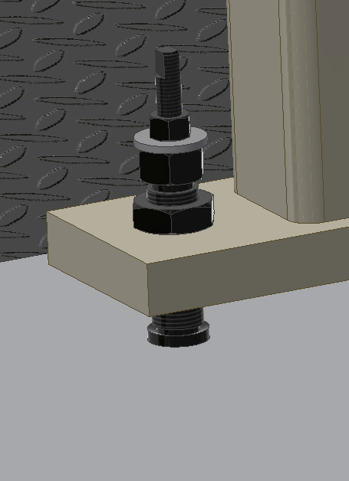
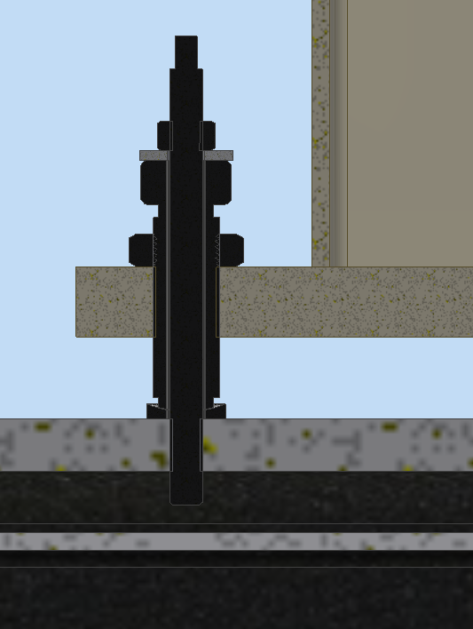
Threaded
stud
Jam nut
Existing Tap Applications
Screw leveling jack body through the tapped base and locate into washer.
Screw threaded stud into existing tap and keep jam nut loose.
Adjust height and secure with jam nut against base frame.
Secure threaded stud to leveling jack with upper jam nut.
Tapped frame
Existing Tap

Slide 5
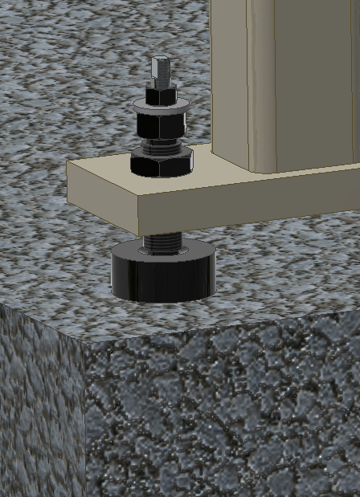
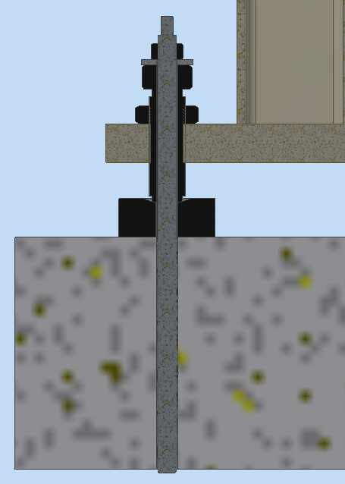
Threaded
stud
Jam nut
Epoxy Anchor Applications
Drill anchoring hole to proper holes size and desired depth. (See dimensional data sheet)
Add epoxy into previously drilled hole
Place mounting block over hole.
Screw leveling jack through the tapped base and locate into mounting block
Place threaded stud through leveling assembly and hammer into floor
Adjust height and secure with jam nut against base frame.
Secure threaded stud to leveling jack with upper jam nut.
Tapped frame
Mounting
block
Concrete floor

Slide 6
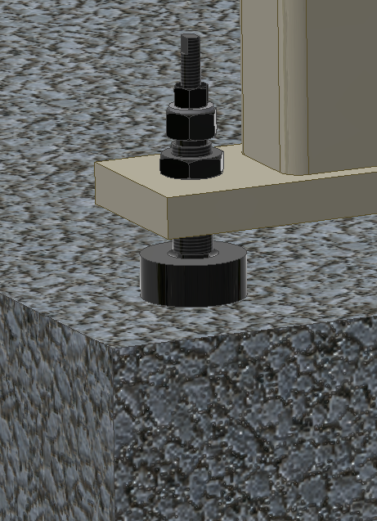
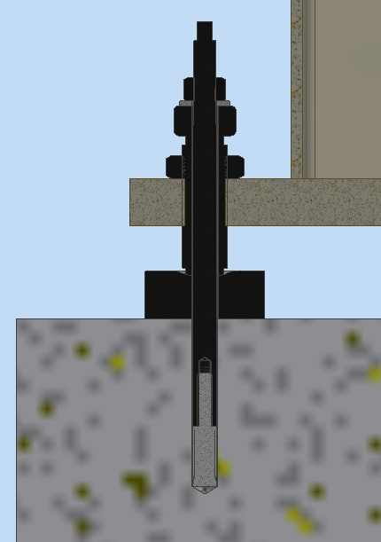
Threaded
stud
Expansion Anchor Applications
Drill anchoring hole to proper holes size and depth. (See dimensional data sheet)
Place mounting block over hole.
Screw leveling jack through the tapped base and locate into mounting block
Place threaded stud with expansion anchor through leveling assembly and hammer into floor
Adjust height and secure with jam nut against base frame.
Turn threaded stud to expand anchor and tighten jam nut to secure.
Jam nut
Tapped frame
Expansion
anchor
Mounting
block
Concrete floor

